Slide 1
Surface Alpha Interactions in PPC HPGe Detectors: Maximizing Sensitivity of ⁷⁶Ge 0νββ Searches
Julieta Gruszko
PhD Defense
University of Washington
Department of Physics
Aug. 4, 2017

Slide 2
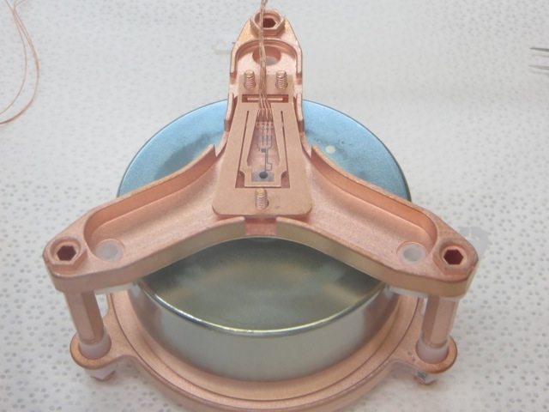
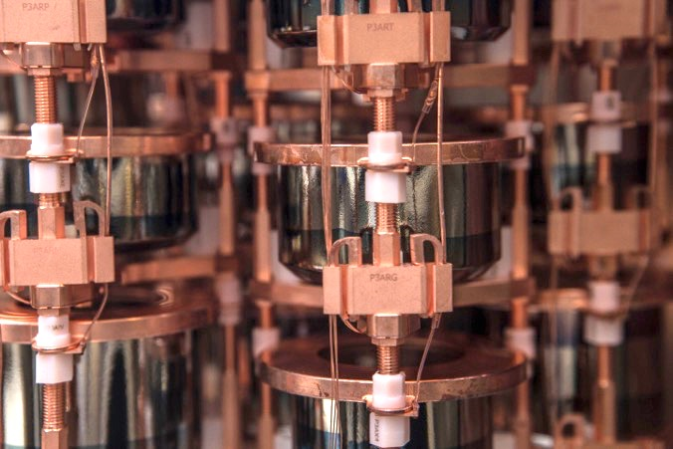
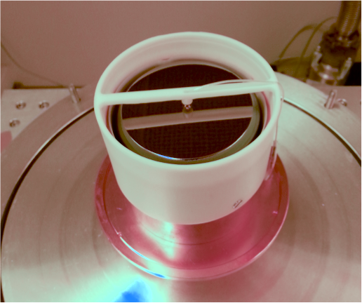
Outline
Introduction to Neutrinoless Double Beta Decay
PPC Detectors and Low-Background Physics
Surface Alpha Identification with DCR
PPC Response Measurement with TUBE
Alpha Backgrounds in the Majorana Demonstrator

Slide 3
Introduction to 0νββ

Slide 4
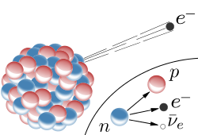
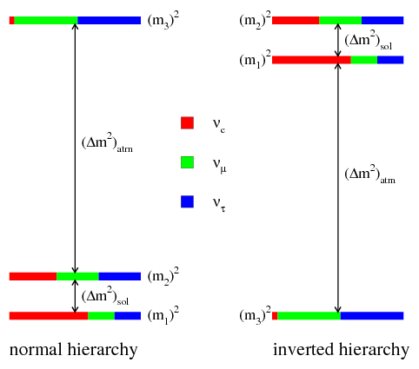
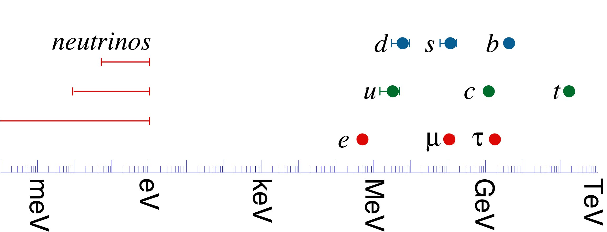
Neutrino Basics
Light, neutral particles
Very low interaction rates
Only and in SM
3 flavors, 3 mass states
Tiny masses (<2 eV), unknown mass hierarchy
Notes:
- Solar neutrino flux on earth is ~7E10 (70 billion) particles /cm2/sec
- neutrinos are 5 to 6 orders of magnitude (1 million times) lighter than other particles

Slide 5
Neutrino Mass
Mass must be BSM
Two ways to give the neutrino mass:
Dirac: Majorana:
4 mass-degenerate states:
2 mass-degenerate states:
makes l⁺
makes l⁻
non-interacting
not in SM
makes l⁺
makes l⁻

Slide 6
Why Majorana Neutrinos?
Combine the two mass terms in a “see-saw mechanism”:
Solves the neutrino mass hierarchy problem, implications for matter/anti-matter asymmetry
2
Majorana Neutrino
4
Dirac Neutrino
Splitting due to Majorana mass
2
Majorana Neutrino

Slide 7
Neutrinoless Double Beta Decay
e⁻
ν_{e}
e⁻
W⁻
ν_{e}
W⁻
ν_{M}
Δl = 2
e⁻
W⁻
e⁻
W⁻
A, Z
A, Z+2
A, Z
A, Z+2
2νββ: a rare SM process that occurs in some nuclei
If neutrinos are Majorana, 0νββ could occur
Lepton number conservation is violated

Slide 8
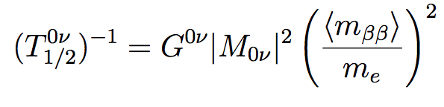
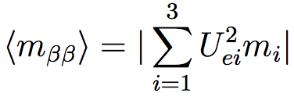
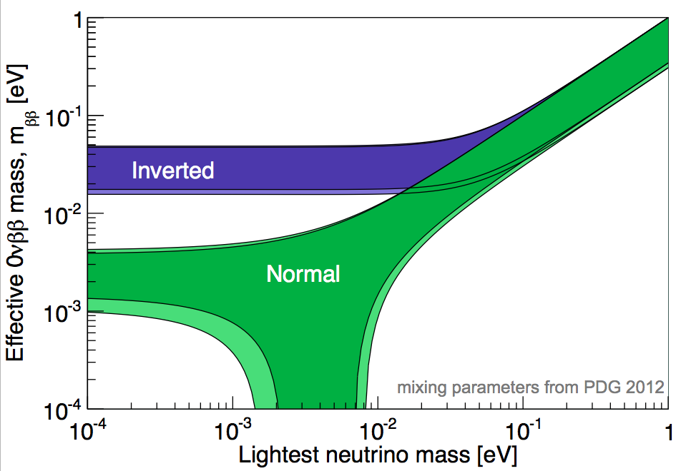
The 0νββ Rate
Rate depends on mixing angles and phases, neutrino mass, and mass hierarchy
Uncertainties in:
m_{ββ}: lightest ν mass, phases, hierarchy
Nuclear matrix elements
Figure courtesy of A. Schubert
Notes:
1 sigma on mixing angles
Split into two slides?
introduce mbb after rate
rate is the thing we measure, and then extract mbb
explain rate

Slide 9
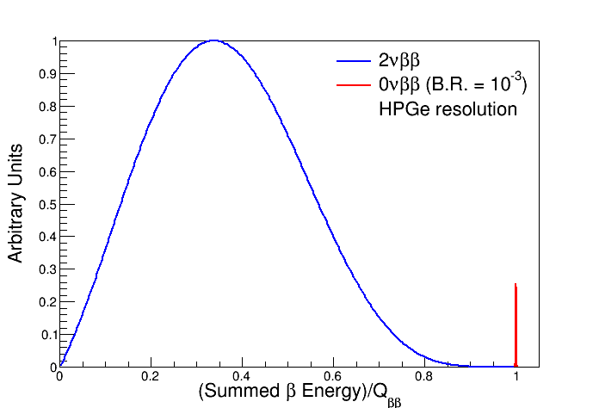
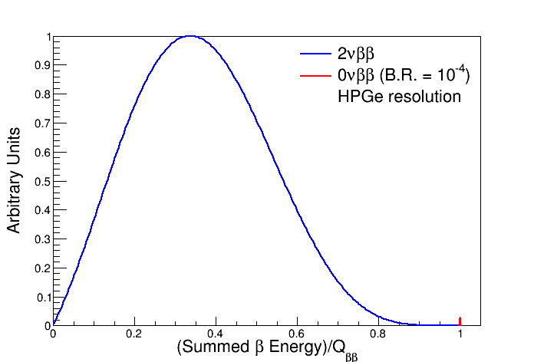
How to Detect 0νββ
Don’t detect neutrinos directly
Ignore the neutrinos, measure the rest of the energy
Current limits:
T_{1/2} > 10²⁵ years
Need a large mass, high efficiency, low background
Notes:
avogradro’s number = 6E23 helps here

Slide 10
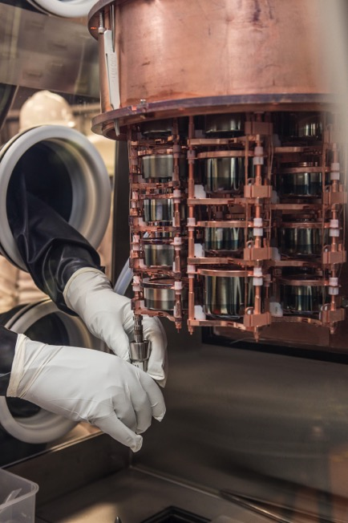
The Majorana Demonstrator
The Majorana Demonstrator (MJD) is an array of enriched and natural germanium detectors that will search for the 0νββ-decay of ⁷⁶Ge.
Goals:
Demonstrate backgrounds low enough to justify building a tonne scale experiment.
Establish feasibility to construct & field modular arrays of Ge detectors.
Searches for additional physics beyond the standard model
Background goal: 3 counts/ROI/t/y after analysis cuts
Q_{ββ} = 2.039 MeV
Prototype taking data: July 2014 – April 2016
Operations: M1 from May 2015, M2 from July 2016
Photo by Matt Kapust

Slide 11
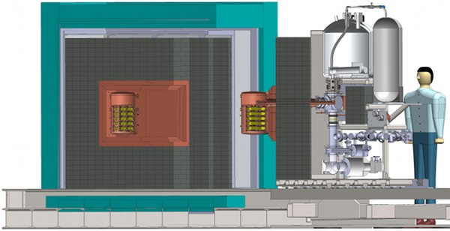
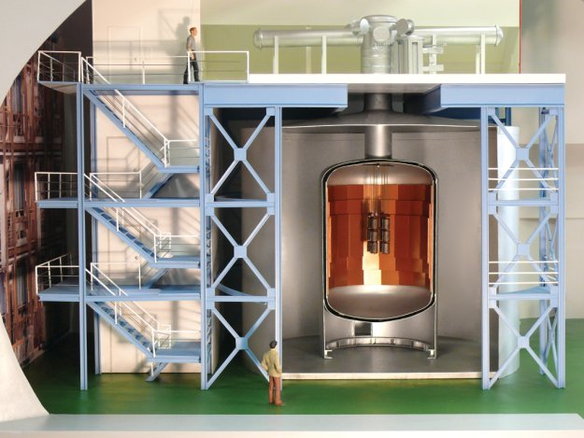
The Present and Future of ⁷⁶Ge 0νββ
The Majorana Demonstrator
GERDA
Parallel efforts using different approaches
MJD: Underground electroformed copper and other ultra-clean materials, mostly passive shielding
GERDA: Slightly higher-background materials, active shielding with LAr
Combine best techniques for tonne-scale experiment
LEGEND Collaboration formed October 2016

Slide 12
Discovery, Background, and Exposure
Figure courtesy of J. Detwiler
Notes:
Take your time!
Start with plot axes
We’re looking for where lines cross
GERDA and MJD will work together to build tonne-scale Ge detector - LEGEND
Start with just the blue lines? add sensitivity

Slide 13
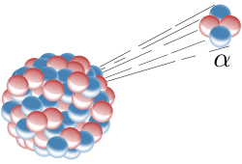
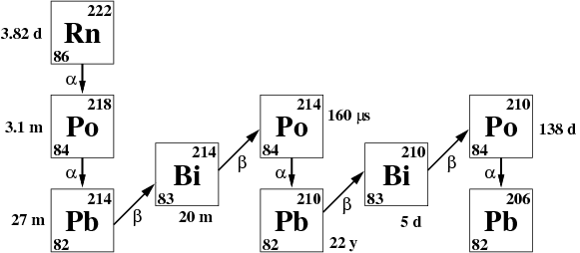
Alpha Backgrounds
Short range, high energy, detected poorly
Radon is the biggest problem
5.3 MeV
Notes:
~20 um in Ge, ~10um in copper
Mention Rn plate-out, can be full energy (if found on detector surface or

Slide 14
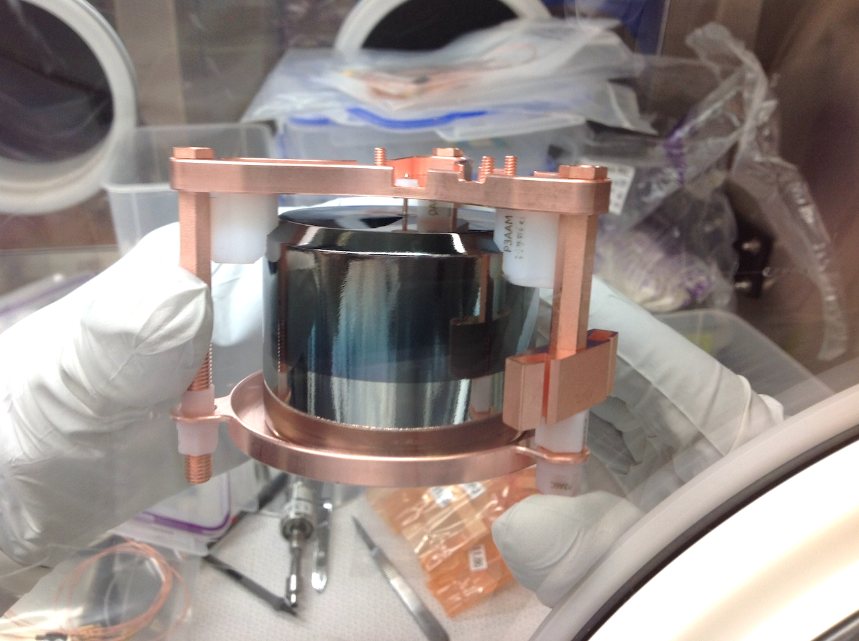
The Majorana Detector Unit
Developed procedure & QA, trained MJD detector-assembly workforce
Holds detector, cabling, front-end electronics

Slide 15
PPC Detectors and Low-Background Physics

Slide 16
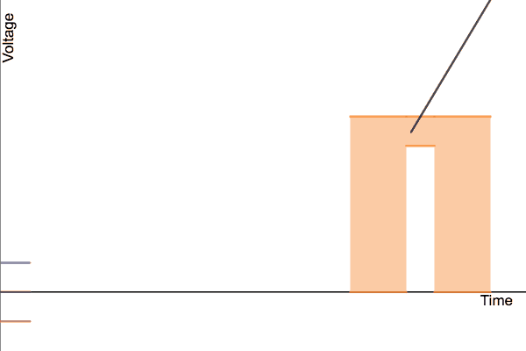
HPGe Detectors
One big Ge diode, fully depleted
Charge proportional to energy
Electron and hole fractions depend on position
In MJ, use enriched Ge (88% ⁷⁶Ge)
γ
+
+
-
-
Charge Integration

Slide 17

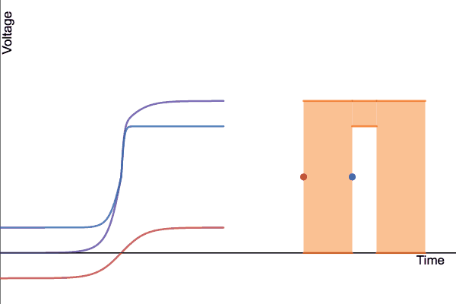
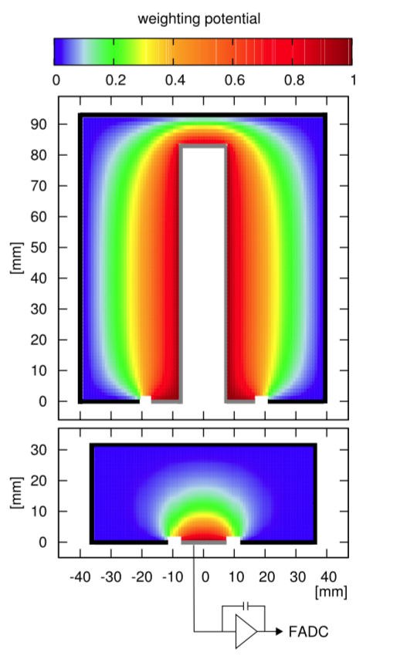
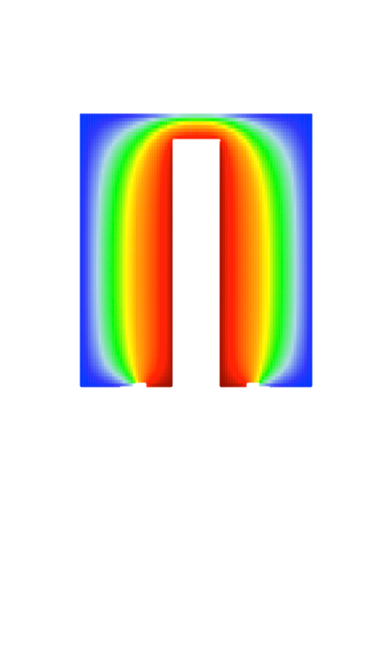
HPGe Detectors
One big Ge diode, fully depleted
Charge proportional to energy
Electron and hole fractions depend on position
In MJ, use enriched Ge (88% ⁷⁶Ge)
γ
+
+
-
-
Charge Integration

Slide 18
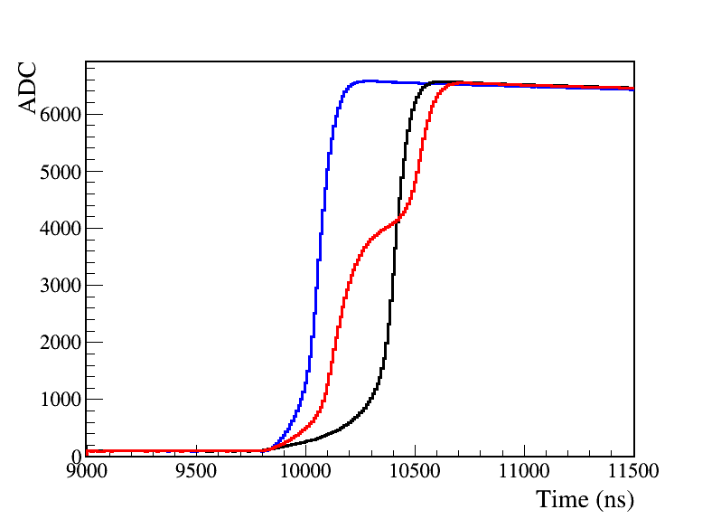
PPC Detectors
Better energy resolution, lower thresholds
Pulse shape highly dependent on position ➔ multi-site PSD
2/0νββ is intrinsically single-site
Decay due to electronics
Notes:
First developed about 15 years ago, this is the first generation of large-scale experiments to use them
Still work to be done to completely understand their behavior

Slide 19
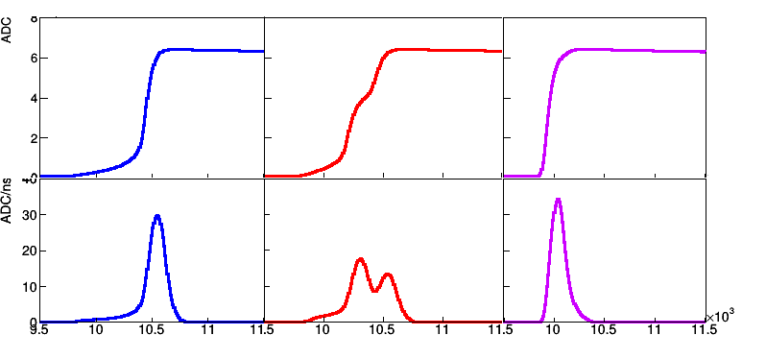
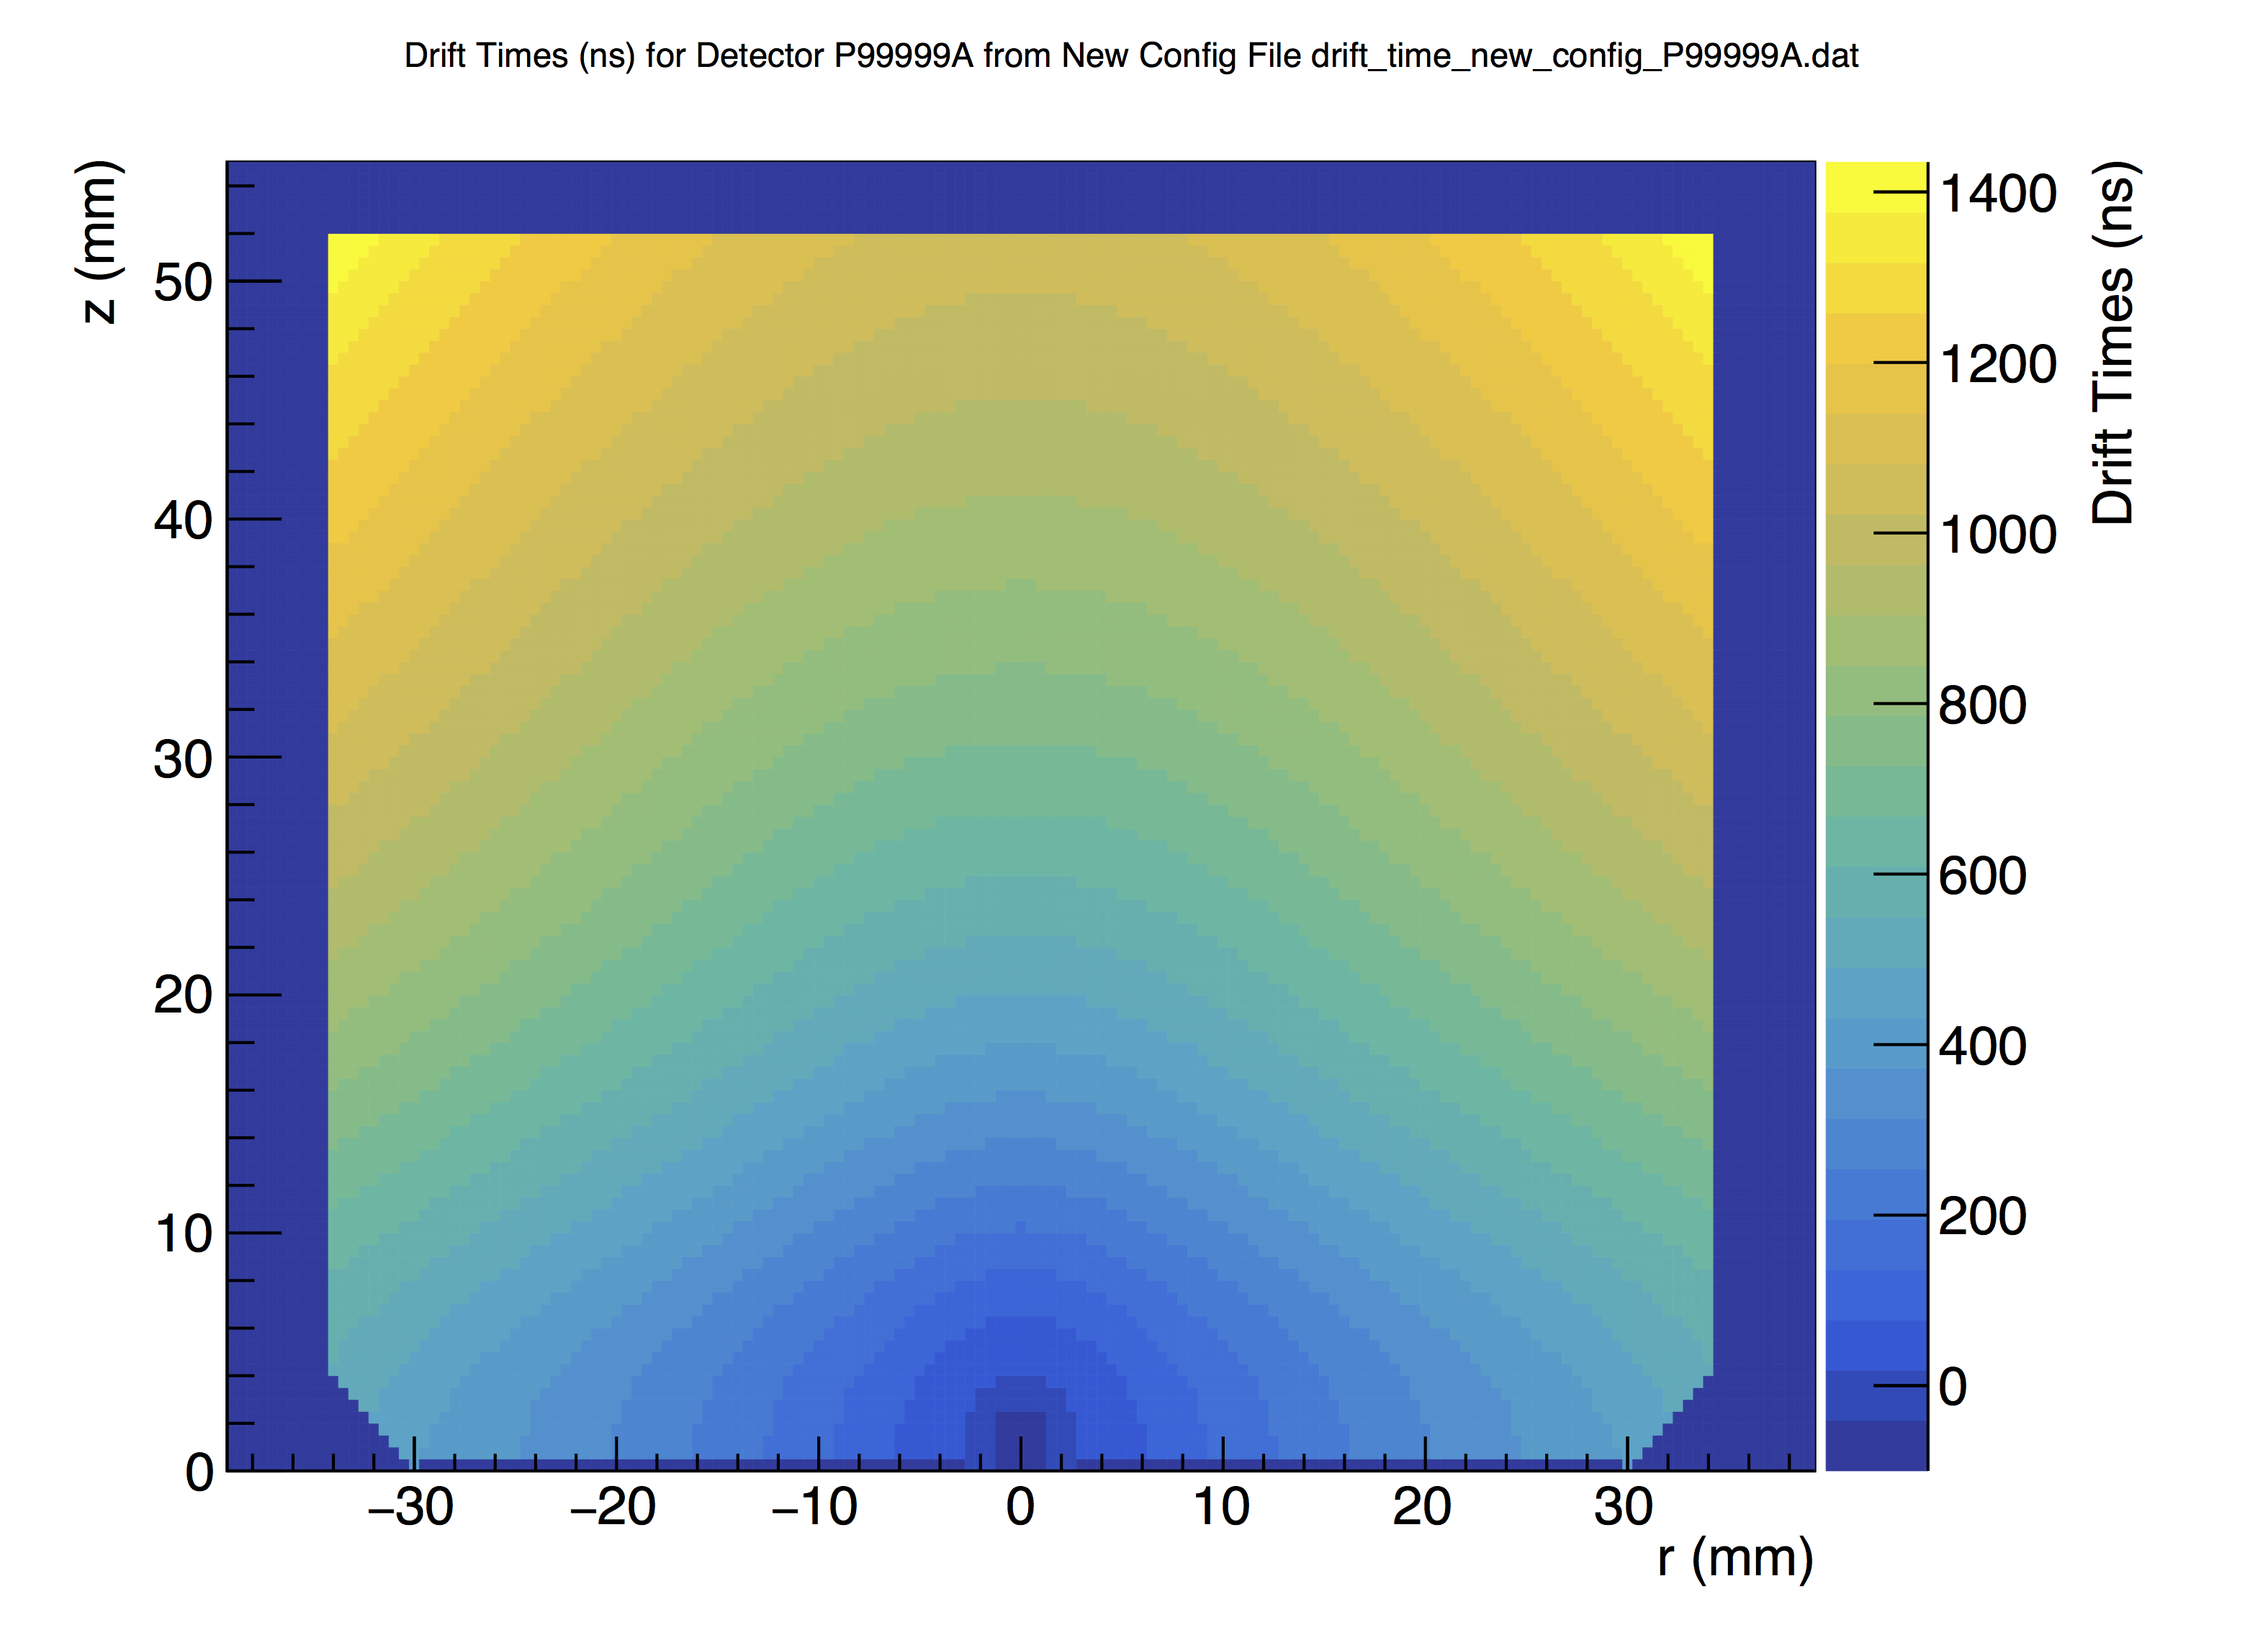
Pulse Shape Discrimination with A/E
Normal SSE
MSE
Near-p+ SSE
Detector Drift Times
Voltage (ADC)
z (mm)
Drift time (ns)
Current (ADC/ns)
r (mm)
Time (μs)
A = maximum current, E = energy
Multi-site events have low A/E
Near-p+ events have high A/E

Slide 20
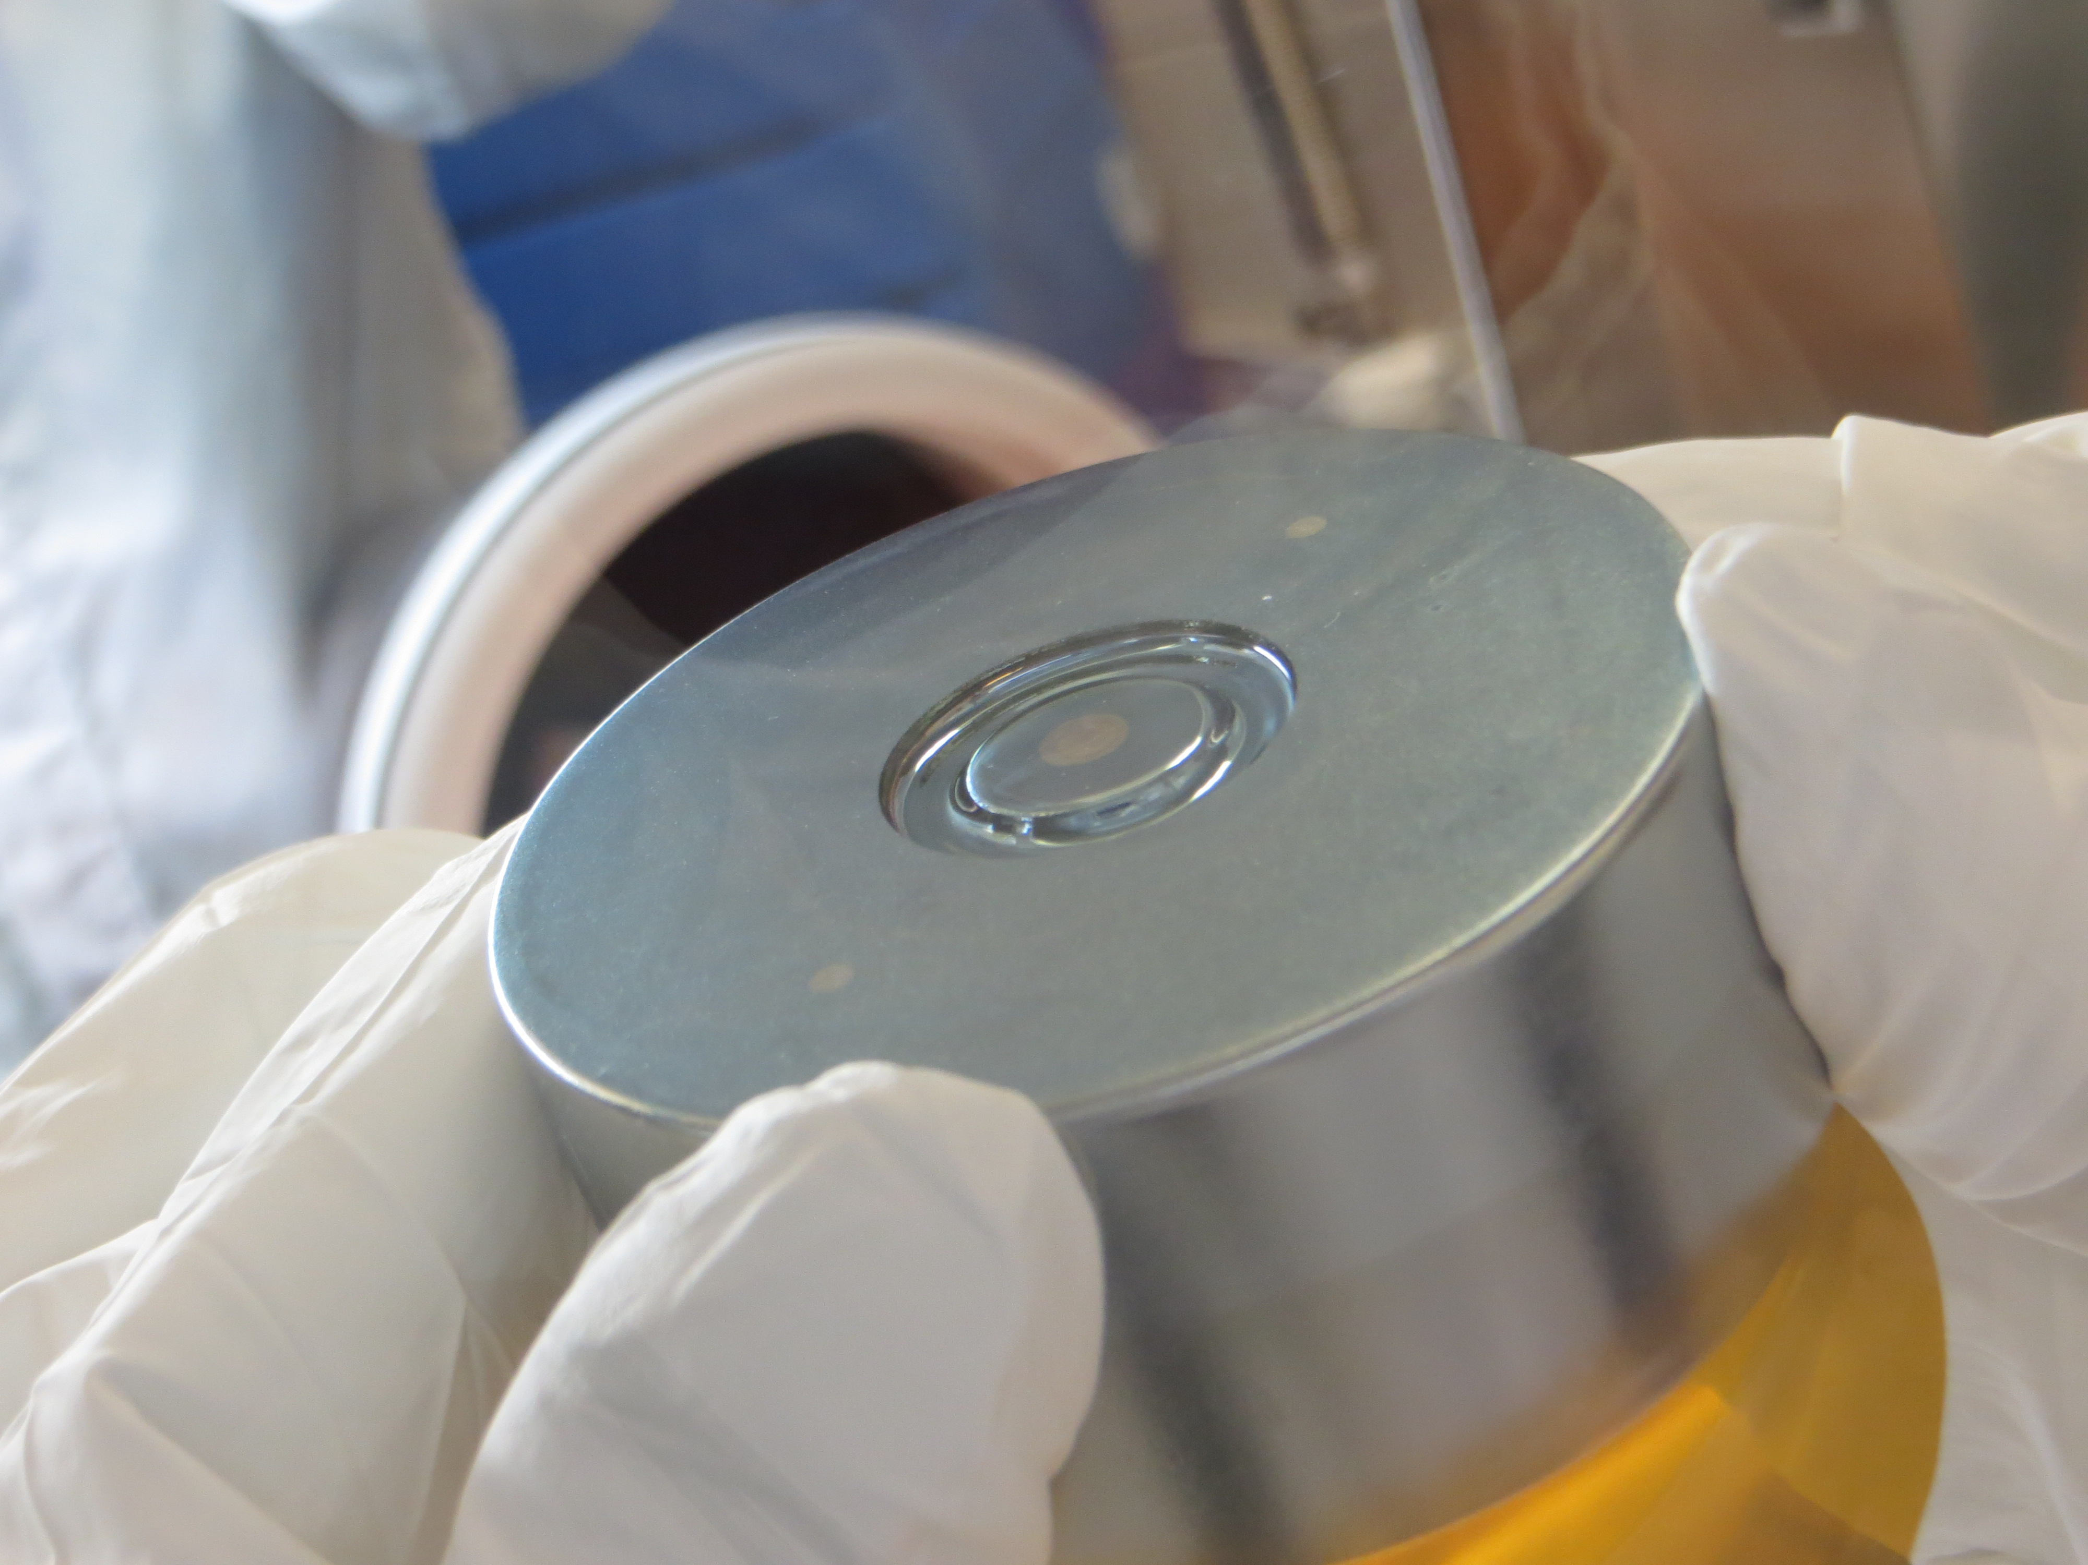
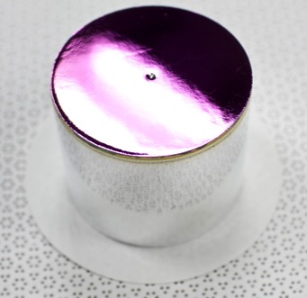
Surface Events
n⁺ contact: .5 mm diffused lithium
α’s don’t penetrate
p⁺ contact: .3 μm implanted boron
α’s barely lose energy
Very fast drift, easy to ID with PSD
Passivated surface: very thin, but poor charge collection
Canberra BEGe Geometry
MJD natural detectors
GERDA enriched detectors
ORTEC Geometry
MJD enriched detectors

Slide 21
Identifying Surface Alphas with DCR

Slide 22
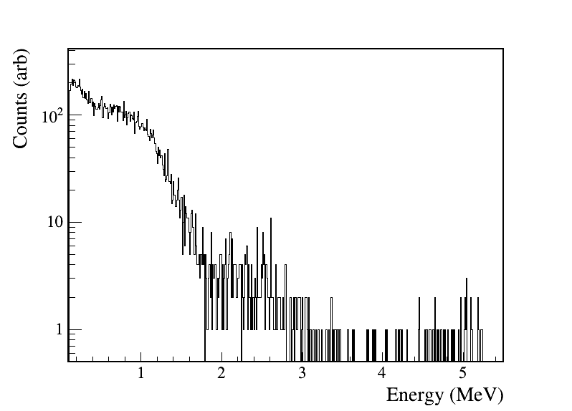
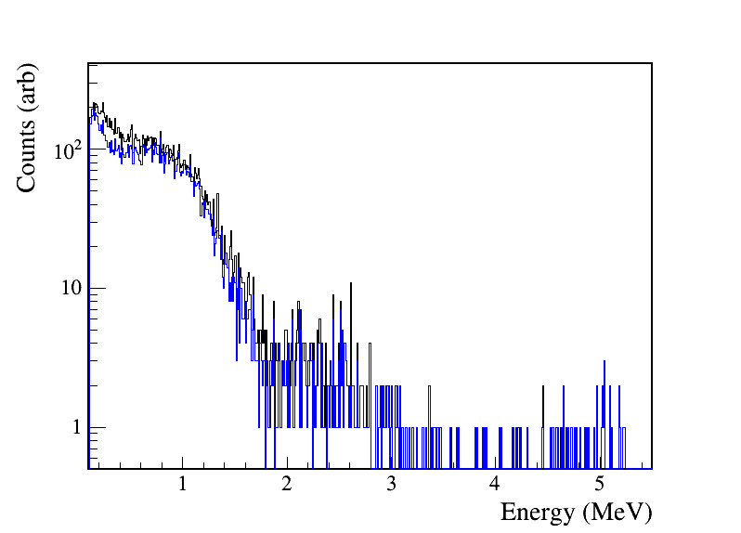
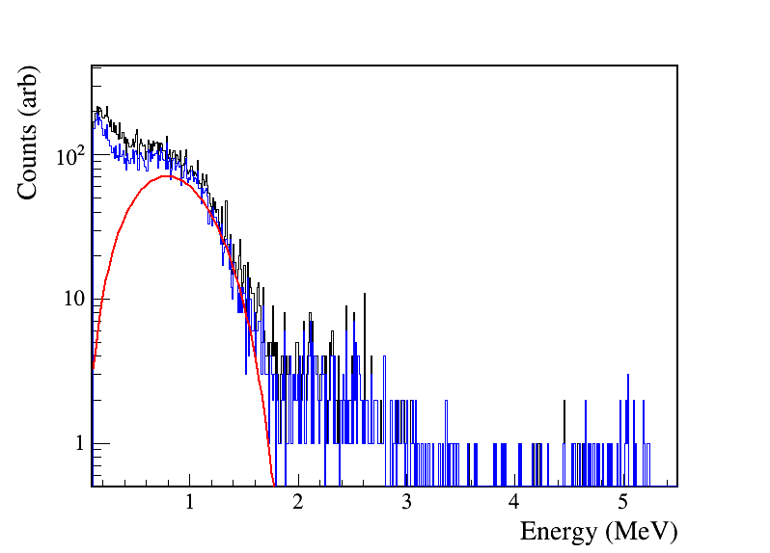
α Background in MJD
The Preliminary MJD Spectrum
Clear ²¹⁰Po peak
Extra structure below 3 MeV
ROI backgrounds far above level expected from assay
Dominant background in ROI
With data cleaning, muon, and mult. cuts
+ MSE rejection
2νββ

Slide 23
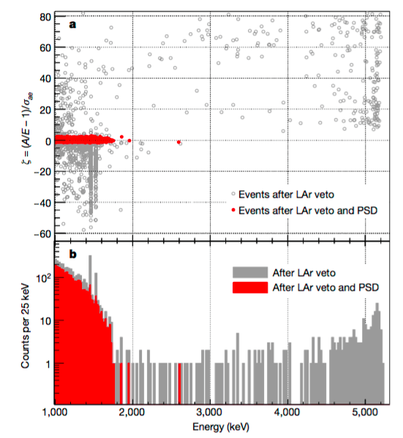
GERDA’s α Background
Approx. 1/2 of ROI events after LAr veto
Not ²¹⁰Pb supported,
t_{1/2} = 138 days
Smaller passivated surface
Fewer α events
All passivated surface events have high A/E
GERDA Spectrum and PSD
A/E
ORTEC
BEGe
Counts
n+
passivated
p+
Energy (keV)
The GERDA Collaboration. Background-free search for neutrinoless double-decay of ⁷⁶Ge with GERDA. Nature, 544(7648):47–52, 04 2017.

Slide 24
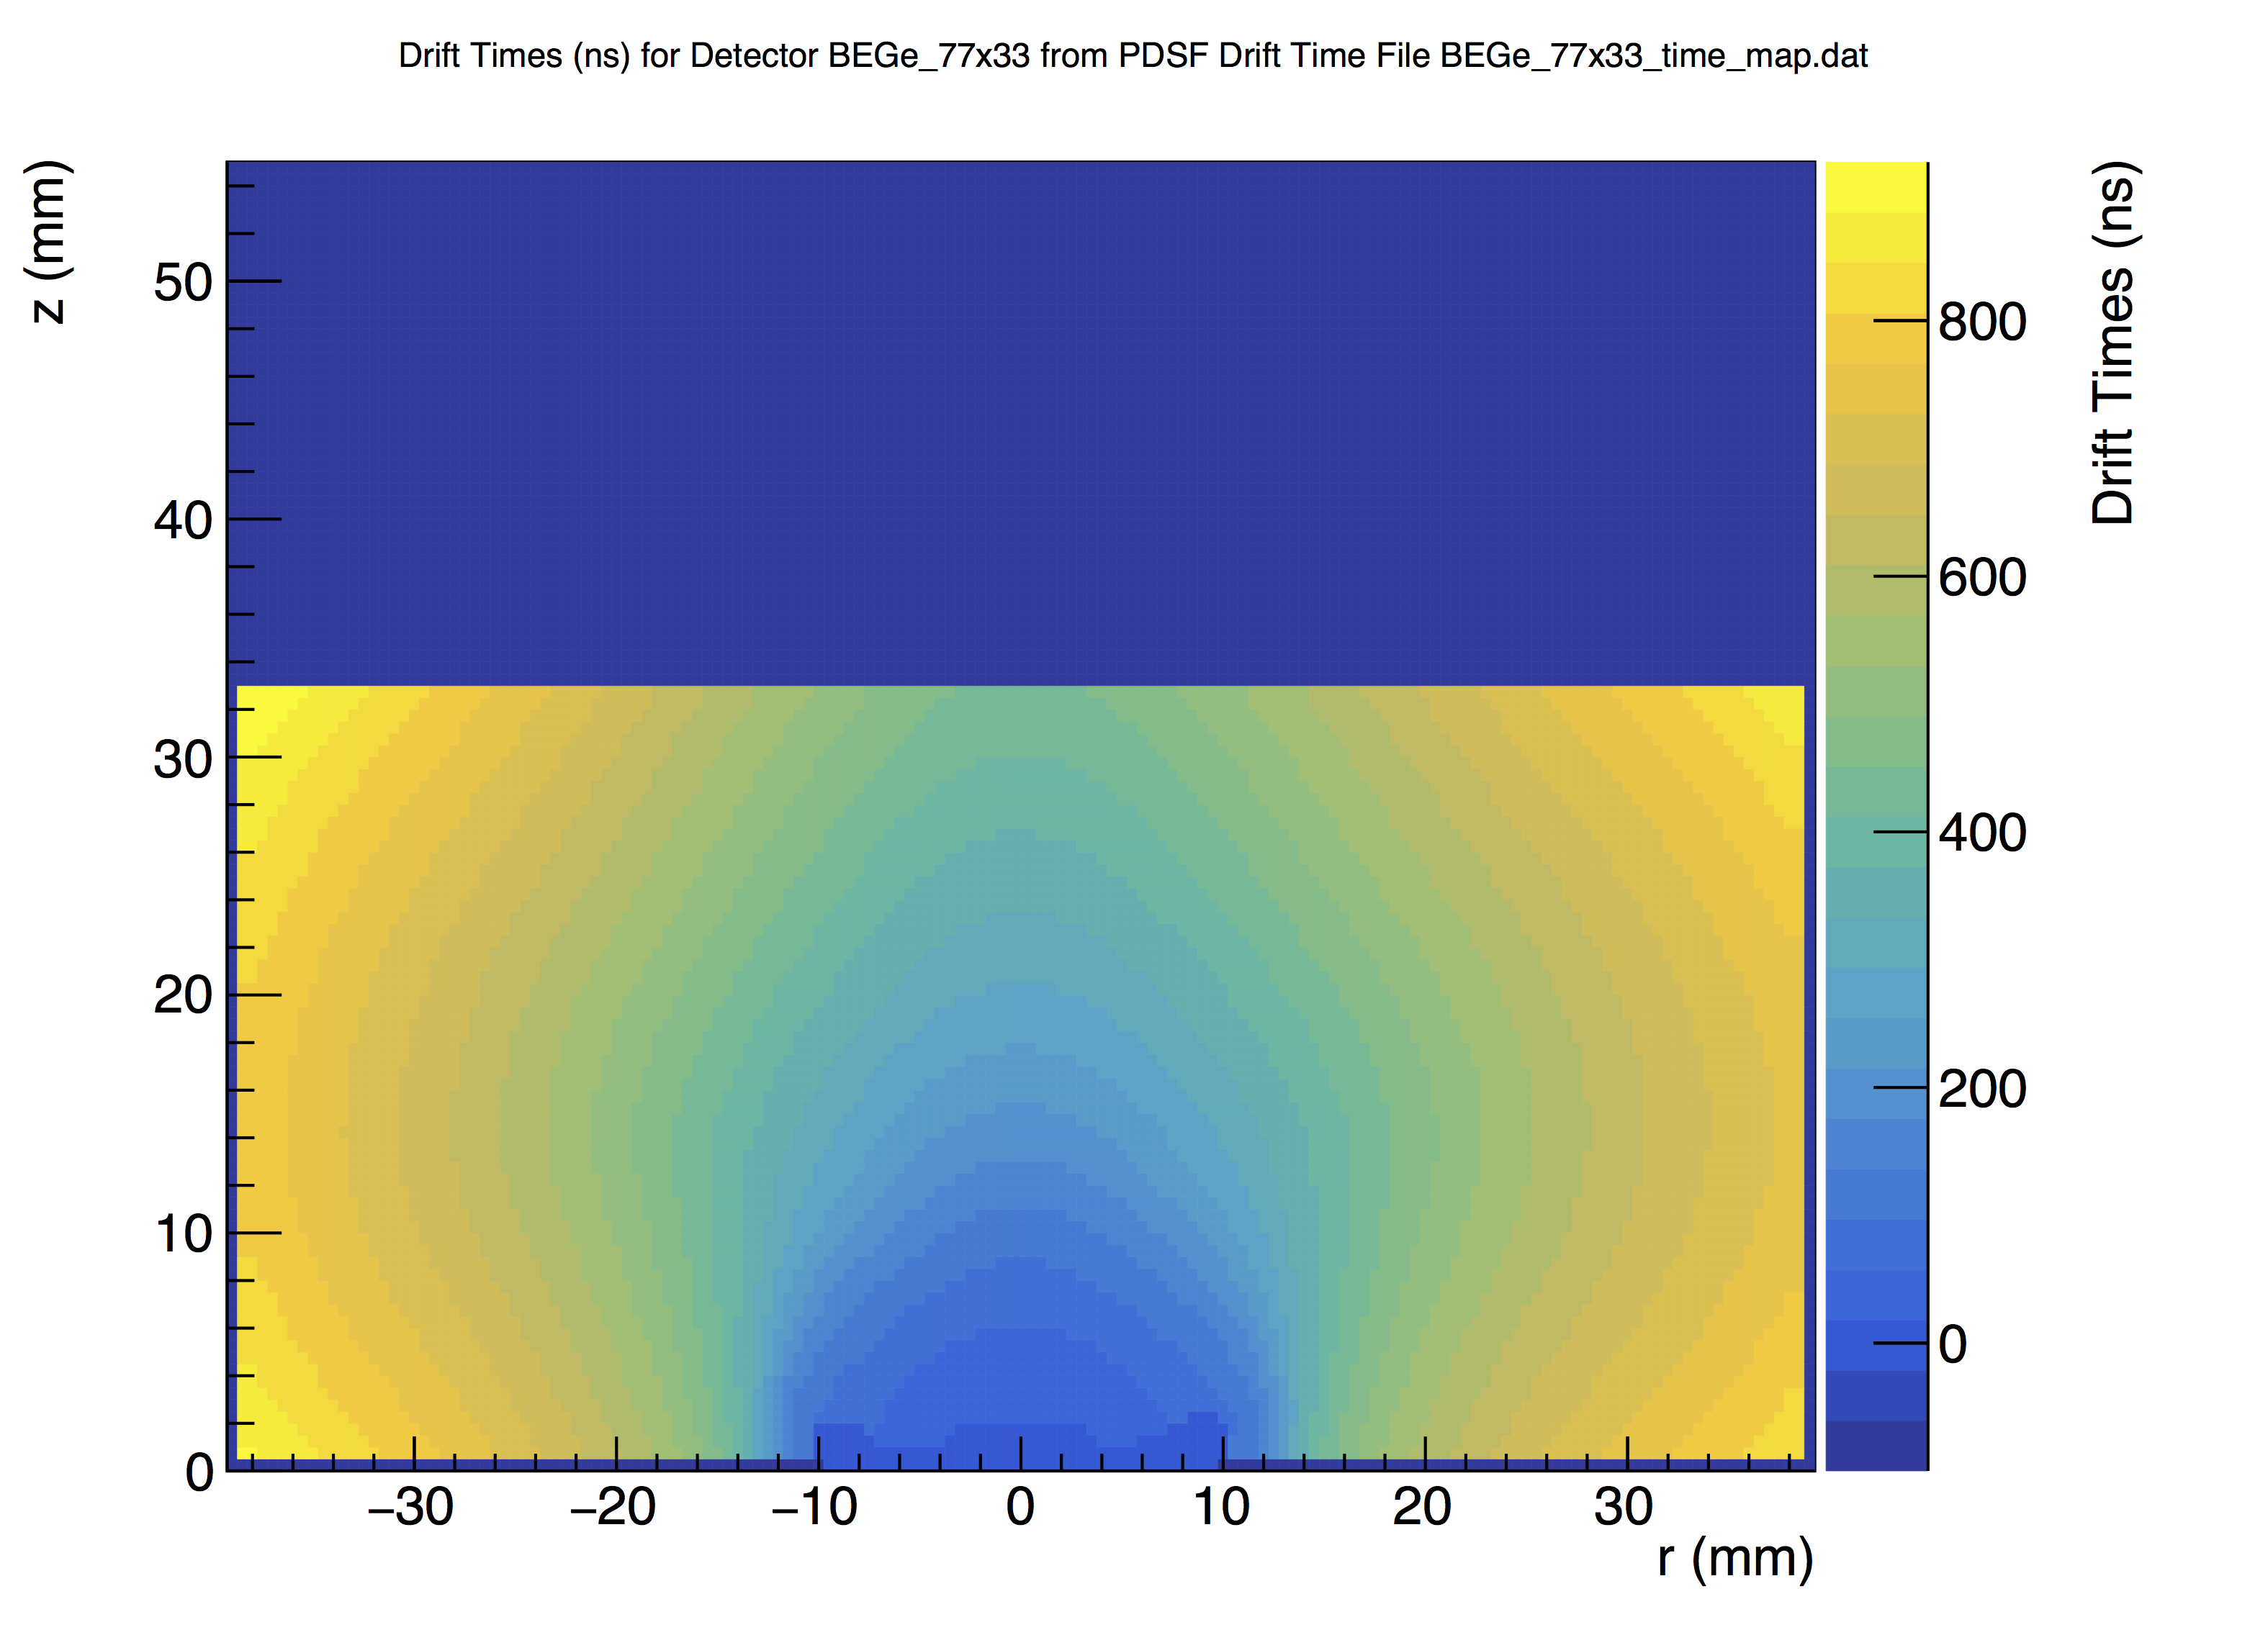
Detector Geometry and α Rejection
ORTEC Drift Time Map
BEGe Drift Time Map
z (mm)
z (mm)
Drift Time (ns)
Drift Time (ns)
r (mm)
Passivated Region
r (mm)
High A/E is a fiducial volume cut– removes bulk events
Would be better to cut based on specific surface behavior

Slide 25
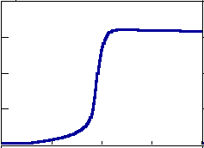
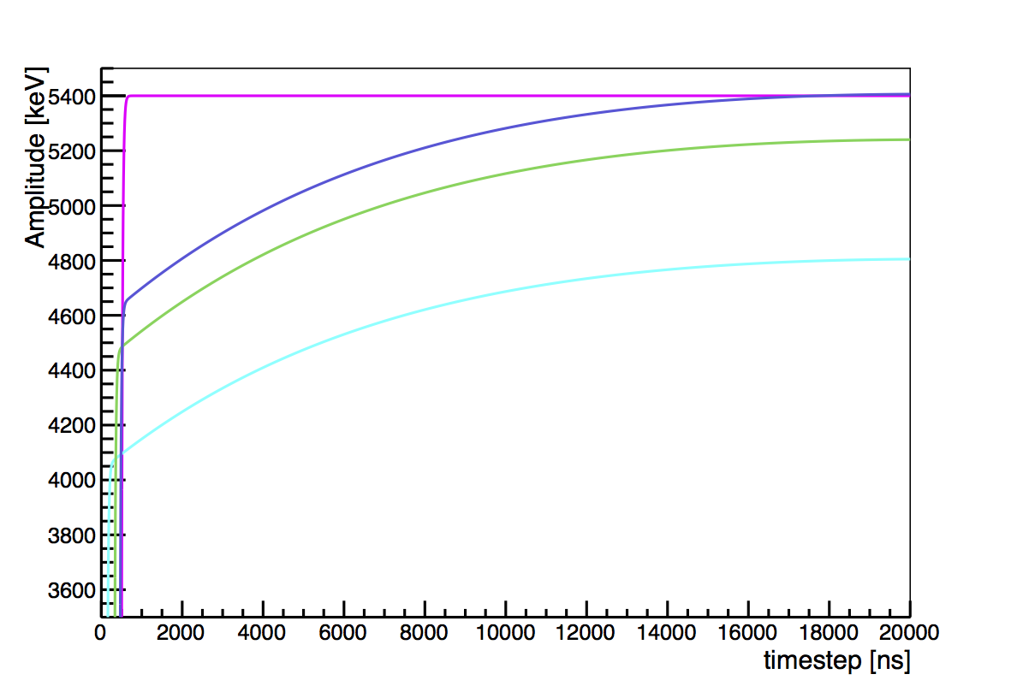
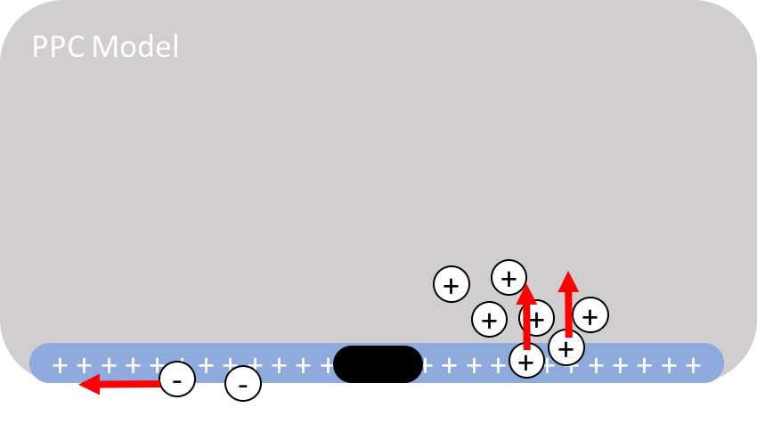
Passivated Surface Pulse Shapes
Some of the charge collected normally
Delayed charge recovery (DCR) from:
Surface drift of electrons on surface
Near-surface hole trapping and slow re-release
Simulated with siggen
r = 21.5 mm
r = 11.5 mm
r = 1.5 mm
Siggen developed by David Radford
Simulations by Susanne Mertens

Slide 26
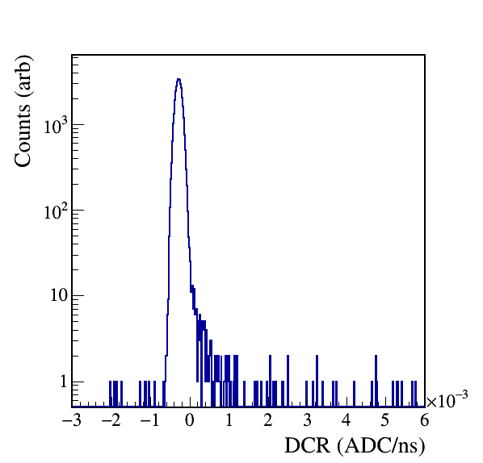
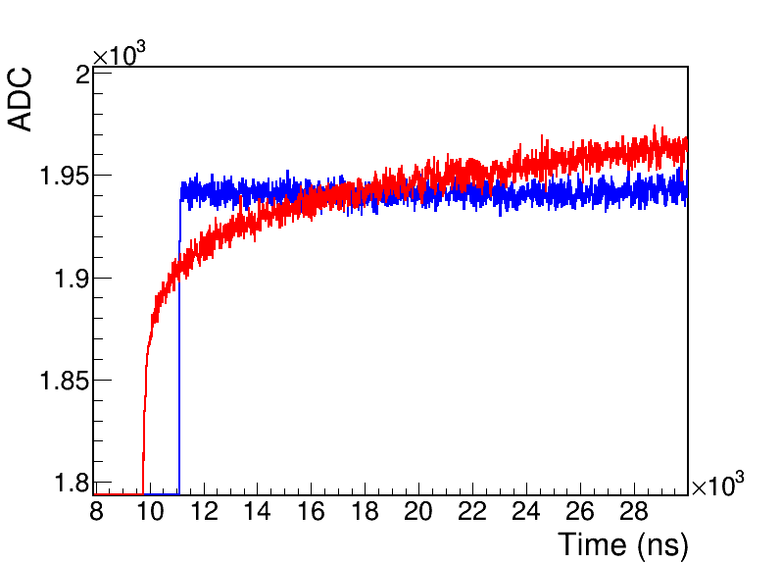
The DCR PSD Parameter
Correct for decay from electronics
Measure slope of tail
Cut events with high DCR
Keep 99% of γ calibration events
α
γ
Publication in preparation

Slide 27
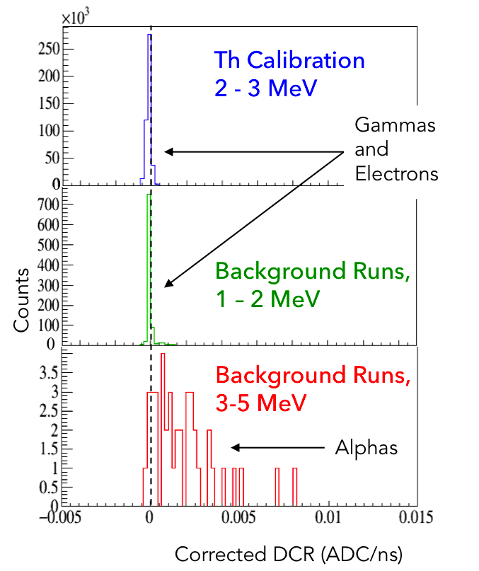
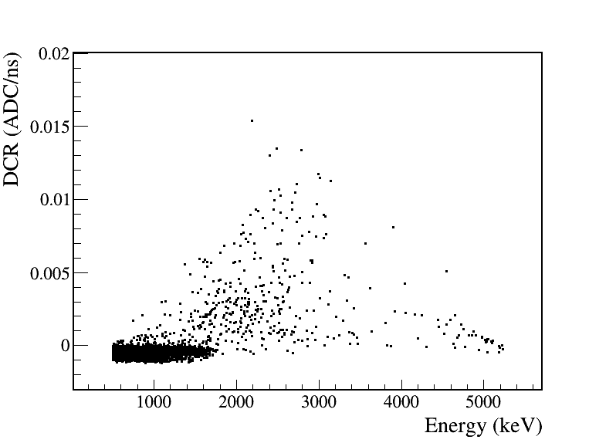
Preliminary Tests in MJD
Events cut:
10% of single-site calibration events between 1 and 2.38 MeV
16.4% with energy between 1 and 2 MeV
88.4% with energy between 2 and 3 MeV
Need dedicated α data to validate
MJD Preliminary Data,
Enriched Detectors

Slide 28
Measuring PPC Response with TUBE

Slide 29
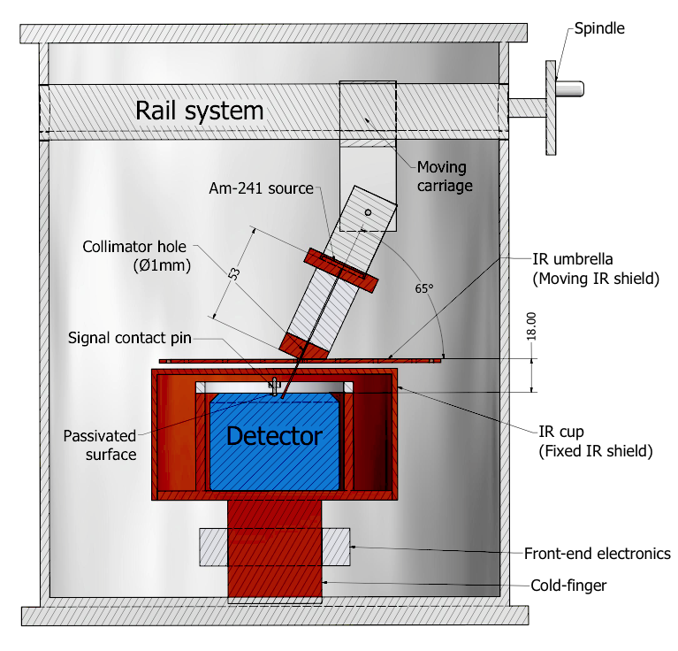
The TUM Upside-Down BEGe (TUBE) Scanner
First joint work between GERDA and MJD groups
Adapted existing alpha scanning system to scan MJD detector
First assembled Sept. 2016, data taken Feb. – June 2017
Questions:
Energy spectrum
E vs. R
DCR vs. R
Charge loss mechanism
A/E and DCR complementarity
DCR α rejection power
7cm

Slide 30
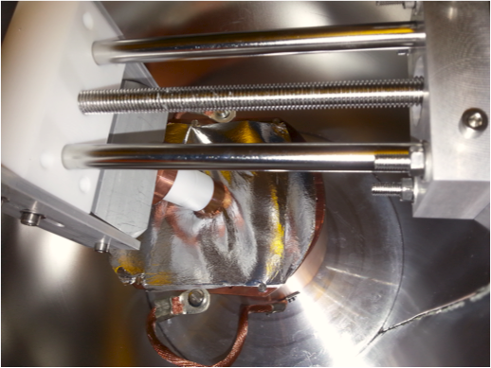
TUBE Measurements
²⁴¹Am source:
5.486 MeV α, 20 keV line-width
40 kBq, 65 events/hour
1 mm collimator ➔ 1.8mm spot size
Scanned every 1.5 mm, 65° angle of incidence, some extra half-positions
Distances from point-contact are radial
24 hours per scan position
65°

Slide 31
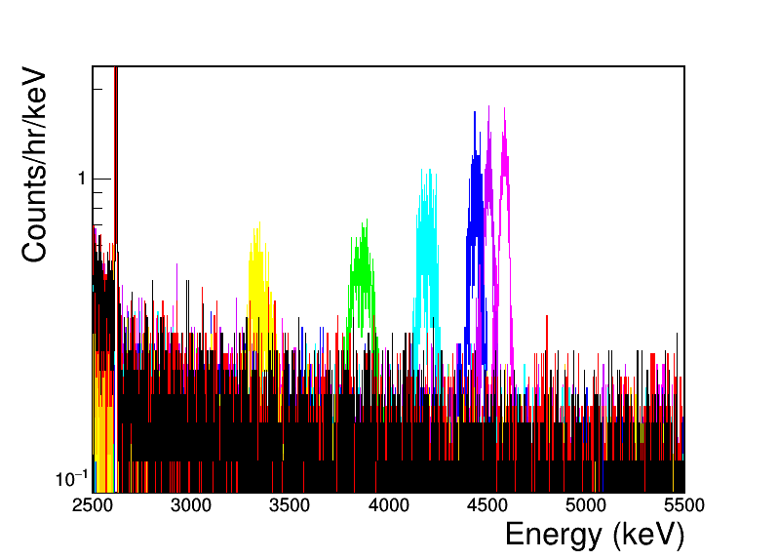
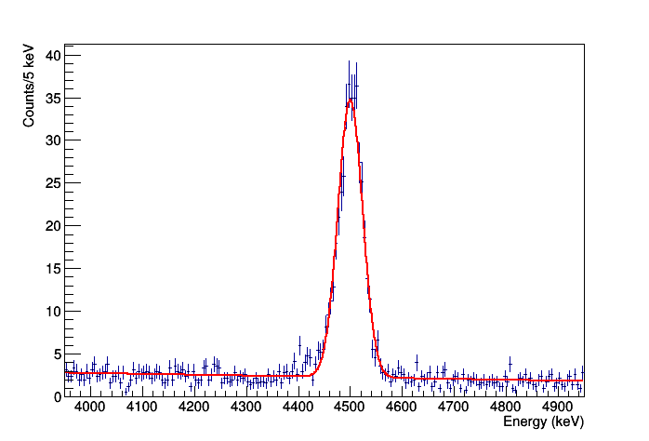
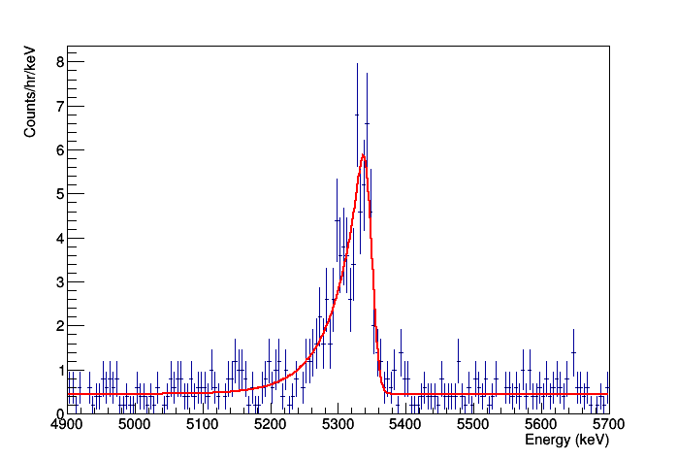

Alpha Energy
TUBE Energy Spectra
r = 24 mm
FWHM = 56 keV
p+ events
FWHM_{gaus} = 21 keV
30 mm

Slide 32
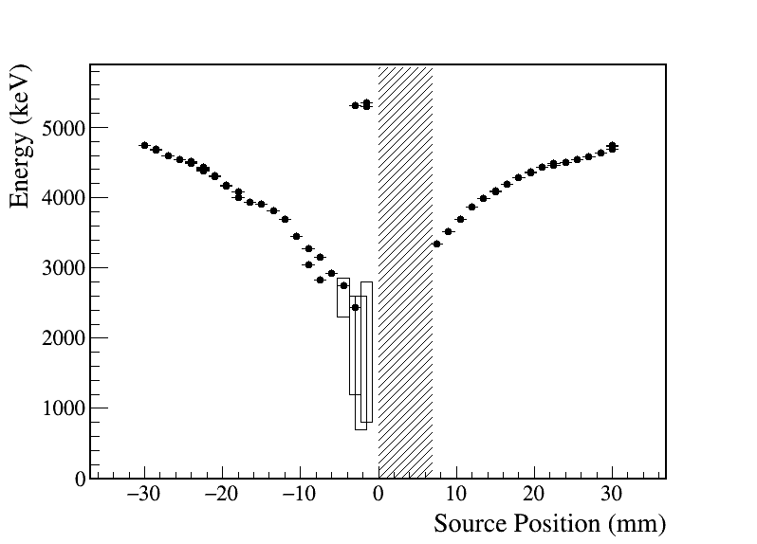
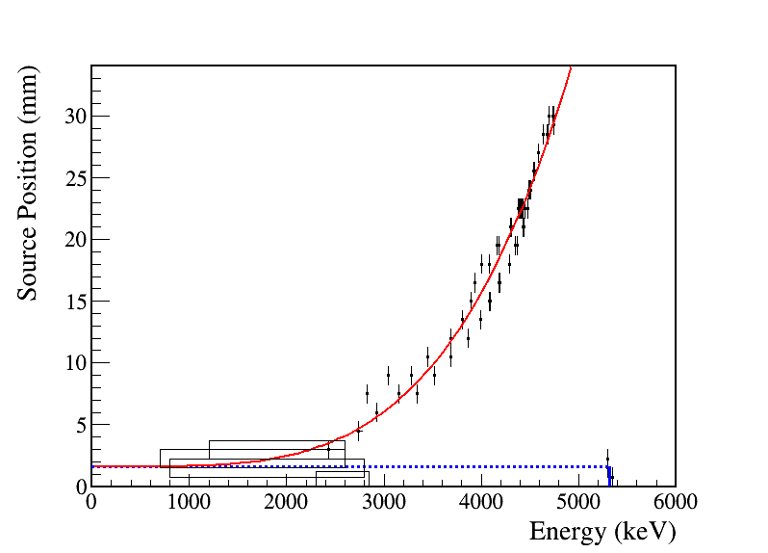
E vs. R
E vs. R
Fitting to R vs. E
WP at Passivated Surface
Passivated surface:
r = aE⁴+r_{p}
Can’t just be electron loss!
Notes:
Fit with a single free parameter, scaling parameter a
Later, I’ll show you how this can be used to model alpha backgrounds

Slide 33
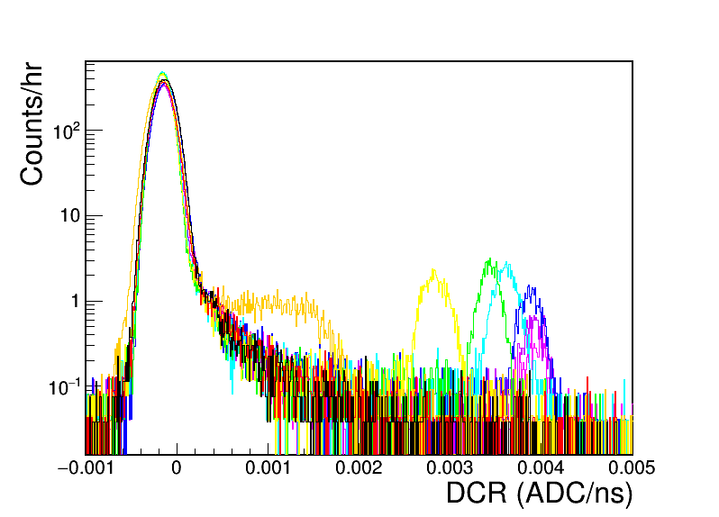
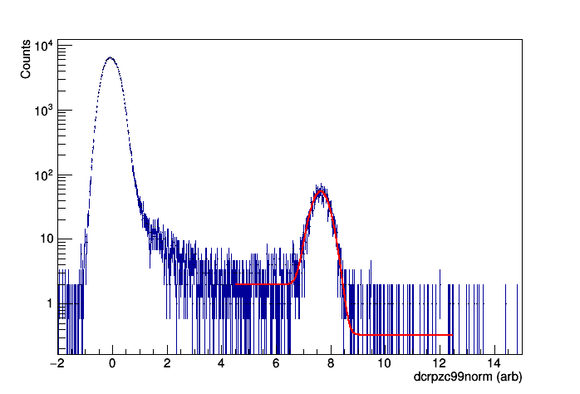
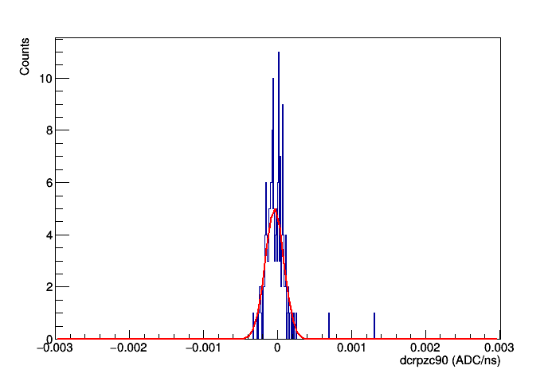
Alpha DCR
TUBE DCR Distributions
r = 24 mm
p+ events
60 mm
30 mm

Slide 34
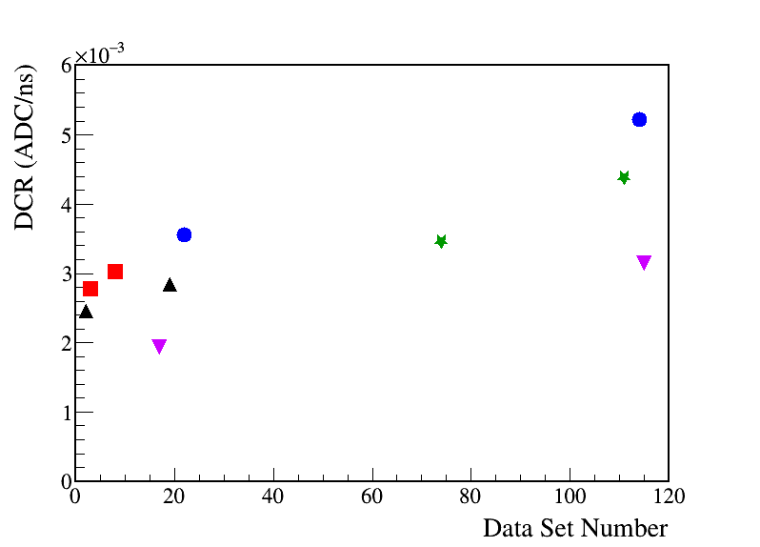
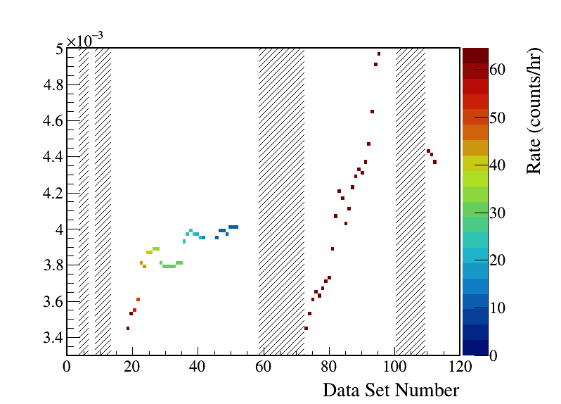

Unexpected Result: DCR Stability
DCR values increase over time, high α rate appears to cause charge build-up. Drops when source is removed from surface.
2 leading theories about mechanism, can test in the future
Not relevant for MJD (rate is ~5 orders of magnitude lower)
DCR of Repeated Positions
DCR over Time, with α Rate:
DCR (ADC/ns)
DCR (ADC/ns)
r = -15mm
r = -9mm
r = -7.5mm
r = -4.5mm
r = -30mm
Higher integrated rate,
larger increase in DCR

Slide 35


DCR vs. R
DCR vs. R
2 – 3.5% of event energy is collected as delayed charge at positions more than 8mm away from p+ contact:
Delayed Charge Fraction vs. R
Events near p+ contact have rapidly falling DCR

Slide 36

Charge Loss Mechanism
Delayed Charge Fraction vs. |R|
WP at Passivated Surface
DCR increases with energy and radius
Hole recovery dominates DCR mechanism
Suggests near-surface trapping & rerelease

Slide 37


A/E and DCR Complementarity
A/E (arb)
30 mm
99.9% Bulk
DCR Acc.
99.9% Bulk
A/E Acc.
DCR (arb)
All positions fall above 99.9% on either A/E or DCR
We should be able to remove ~all α events w/ minimal sacrifice

Slide 38

A/E and DCR α Rejection Power
BEGe passivated surface
5σ DCR
99.9% Bulk
DCR Acc.
5σ A/E
99.9% Bulk
A/E Acc.
99% A/E and DCR
DCR or A/E (σ)
Distance from P-contact (mm)
Suggests that the transition is at ~8mm
Publication in preparation

Slide 39
Alpha Backgrounds in MJD

Slide 40

DCR and Alpha Backgrounds
DCR reduces ROI background rate by a factor of 31
After cut, ROI backgrounds are within uncertainty of 3 counts/ROI/t/y
At current exposure, improves 0νββ limit by 24%
After 5 years of running, improves sensitivity by a factor of 3
Corresponds to $8.5m-worth more ⁷⁶Ge
MJD Preliminary Spectrum, Enriched Detectors
With data cleaning, muon, and mult. cuts
+ MSE rejection
+ α rejection
Notes:
14 more detectors

Slide 41
Pin-point Background Modeling
Using TUBE α spectrum, distinguish between background sources
65°
θ
or
Completely analytic, for now
A few caveats:
rescale energies (²¹⁰Po, not ²⁴¹Am)
p+ deadness fraction
p+ α peak shape

Slide 42


Testing Two Models
Constant Across Surface
MJD enr. data
Projected α spec.
Can immediately discard constant model
Point Source Above Surface
0 < h < 20 mm
Counts (arb)

Slide 43

Fitting to α Source
Just two free parameters: height and overall scaling (α rate)
Strongly suggests plastic bushing is responsible
Full simulation needed
Fitting α Spectrum to MJD Data
MJD enr. data
Projected α spec.
4.92 mm
3.65 mm
h ~3.8 mm

Slide 44

Conclusion
I have characterized PPC charge collection near the passivated surface and identified the cause of the observed delayed charge recovery.
Using the DCR cut, the MJD background has been reduced by a factor of ~30, improving sensitivity by a factor of 3.
Using TUBE results, we can model the spectrum of α events, even identify their source. Then high-α background parts can be removed in MJD and avoided in LEGEND.
Improved understanding of PPC behavior can drastically improve our ability to search for rare events and BSM physics, like 0νββ.

Slide 45



Thank You to:
the money:
UW Physics, ARCS, NSF, and DOE
the Majorana and GERDA Collaborations, and all of the staff at CENPA
the MJ groups at UW and at TUM
my committee, and particularly to Jason
all of my family and friends
This material is based upon work supported by the National Science Foundation Graduate Research Fellowship under Grant No. 1256082. Any opinion, findings, and conclusions or recommendations expressed in this material are those of the authors(s) and do not necessarily reflect the views of the National Science Foundation.
This material is based upon work supported by the U.S. Department of Energy, Office of Science, Office of Nuclear Physics, the Particle Astrophysics and Nuclear Physics Programs of the National Science Foundation, and the Sanford Underground Research Facility.

Slide 46
Extra Slides

Slide 47
Unexpected Result: DCR Stability
Two potential causes
Deep trap filling: Surface channel formation:
+
+
E
-
-
-
Test under changing temperature to distinguish

Slide 48


MJD Alpha Backgrounds
Identified high α-rate detectors
²¹⁰Po is Pb-supported
But α rejection is already good, and can still be improved
7 detectors have rates inconsistent with the average

